Slide 1

JSP Standart Tag Library-JSTL

Slide 2
Objectives
This session is learning about the jstl:
  What jstl is
  Why do we use it
  Tag libraries included in jstl
  A detailed glance to the jstl-core library
  The other libraries and their functions
  How to use the jstl in a project

Slide 3
What JSTL is?
JSTL (JSP Standard Tag Libraries) is a collection of JSP custom tags developed by Java Community Process, www.jcp.org.
The goal of JSTL is to help simplify JavaServer Pages page authors' lives. To achieve this goal, JSTL has provided custom tags for many common JSP page authoring tasks that require scripting statements to manipulate server side dynamic data.

Slide 4
What JSTL offers?
General-purpose actions: Displaying, scope, setting and removing jsp scoped attributes, catching exceptions.
Control flow actions: Conditional, iterators…
Tag library validators: TLVs allow projects to only allow specific tag libraries, as well as enforce JSP coding styles that are free of scripting elements

Slide 5
What JSTL offers? (2)
The other key aspects of JSTL are:
  ■ Accessing URL-based resources
  ■ Internationalization (i18n) and text formatting
  ■ Relational database access (SQL)
  ■ XML processing
  ■ String manipulation

Slide 6
JSTL Tag Libraries
Functional Area | URI | Prefix
Core | http://java.sun.com/jsp/jstl/core | c
Xml Processing | http://java.sun.com/jsp/jstl/xml | x
I18N capable formatting | http://java.sun.com/jsp/jstl/fmt | fmt
Relational database accesing (SQL) | http://java.sun.com/jsp/jstl/sql | sql
Functions | http://java.sun.com/jsp/jstl/functions | fn

Slide 7
General Purpose Actions
Uri=http://java.sun.com/jsp/jstl/core , prefix=c
  <c:set>
    Set the value of a scoped variable using attribute value
    <c:set value=”value” var=”varName” [scope=”{page|request|session|application}”]/>
    Set the value of a scoped variable using body content
    <c:set var=”varName” [scope=”{page|request|…}”]>
    body content </c:set>
    Set a property of a target object using attribute value
    <c:set value=”value” target=”target” property=”propertyName”/>
    Set a property of a target object using body content
    <c:set target=”target” property=”propertyName”>
    body content </c:set>
    Set a deferred value
    <c:set var=”varName” value="deferred-value"/>

Slide 8
General Purpose Actions (2)
  <c:remove>
    The natural companion to <c:set>, allowing the explicit removal of scoped variables
    <c:remove var="cachedResult“ scope="application"/>
  <c:catch>
    provides a complement to the JSP error page mechanism
    <c:catch var=”exception”>
    <!-- Execution we can recover from if exception occurs -->
    ...
    </c:catch>
    <c:if test=”${exception != null}”>
    Sorry. Processing could not be performed because...
    </c:if>

Slide 9
General Purpose Actions (3)
  <c:out>
    Without a body
    <c:out value=”value” escapeXml=”{true|false}”]
    [default=”defaultValue”] />
    With a body (jsp body)
    <c:out value=”value” [escapeXml=”{true|false}”]>
    default value </c:out>

Slide 10
Conditional Actions
  <c:if>
    Without body content
    <c:if test=”testCondition” var=”varName” [scope=”{page|request|…}”]/>
    With body content (jsp body)
    <c:if test=”testCondition” [var=”varName”] [scope=”{page|request|…}”]>
    body content </c:if>

Slide 11
Conditional Actions(2)
  <c:choose>
    <c:choose>
    body content (<when> and <otherwise> subtags)
    </c:choose>
    The body of the <c:choose> action can only contain:
    ■ White spaces
    May appear anywhere around the <c:when> and <c:otherwise> subtags.
    ■ 1 or more <c:when> actions
    Must all appear before <c:otherwise>
    ■ 0 or 1 <c:otherwise> action
    Must be the last action nested within <c:choose>

Slide 12
Conditional Actions(3)
  <c:when>
    Represents an alternative within a <c:choose> action.
<c:when test=”testCondition”>
body content
</c:when>
■ Must have <c:choose> as an immediate parent.
■ Must appear before an <c:otherwise> action that has the same parent.

Slide 13
Conditional Actions(4)
  <c:otherwise>
    Represents the last alternative within a <c:choose> action.
  <c:otherwise>
  conditional block
  </c:otherwise>
  ■ Must have <c:choose> as an immediate parent.
  ■ Must be the last nested action within <c:choose>.

Slide 14
Iterator Actions
  <forEach>
    Iterate over a collection of objects
    <c:forEach[var=”varName”] items=”collection” [varStatus=”varStatusName”][begin=”begin”] [end=”end”] [step=”step”]>
    body content </c:forEach>
    Iterate a fixed number of times
    <c:forEach [var=”varName”] [varStatus=”varStatusName”] begin=”begin” end=”end” [step=”step”]>
    body content </c:forEach>

Slide 15
Iterator Actions (1)
Example 1 – iteration of a collection (Arraylist /vector/…)
  <table>
  <c:forEach var=”product” items=”${products}”
  varStatus=”status”>
  <tr><td>${status.count}”</td>
  <td>${product.name}”</td></tr>
  </c:forEach>
  </table>
Example 2 – iteration of a has map
  <c:forEach var="entry" items="${myHashtable}">
  Next element is ${entry.value}
  </c:forEach>

Slide 16
Iterator Actions(2)
  <c:forTokens>
    Iterates over tokens, separated by the supplied delimiters.
    <c:forTokens items="stringOfTokens“ delims="delimiters“ [var="varName"] [varStatus="varStatusName"] [begin="begin"] [end="end"] [step="step"]>
    body content </c:forTokens>

Slide 17
URL Related Actions
  URL
    import a resource with an absolute URL
    <c:import url=”http://acme.com/exec/customers?country=Japan”/>
    import a resource with a relative URL - same context
    <c:import url=”/copyright.html”/>
    import a resource with a relative URL - foreign context
    <c:import url=”/logo.html” context=”/master”/>

Slide 18
URL Related Actions(2)
  Exporting the content of the url
    Export the content of the URL resource as a String
  <c:import var="customers" url=”http://acme.com/exec/customers?country=USA"/>
    Export the content of the URL resource as a Reader
  <c:import varReader="customers" url=”http://acme.com/exec/customers?country=USA">
      Body content </c:import>

Slide 19
URL Related Actions(3)
  <import>
    Imports the content of a URL- based resource:
    Resource content inlined or exported as a String object
    <c:import url=”url” [context=”context”]
    [var=”varName”] [scope=”{page|request|…}”]
    [charEncoding=”charEncoding”]>
    optional body content for <c:param> subtags
    </c:import>
    Resource content exported as a Reader object
    <c:import url=”url” [context=”context”] varReader=”varReaderName” [charEncoding=”charEncoding”]>
    body content where varReader is consumed by another action
    </c:import>

Slide 20
URL Related Actions(4)
  <c:url>
    Builds a URL with the proper rewriting rules applied.
    Without body content
    <c:url value=”value” [context=”context”] [var=”varName”] [scope=”{page|request|…}”]/>
    With body content to specify query string parameters
    <c:url value=”value” [context=”context”] [var=”varName”] [scope=”{page|request|…}”]>
    <c:param> subtags
    </c:url>

Slide 21
URL Related Actions(5)
<redirect>
  Sends an HTTP redirect to the client.
  Without body content
  <c:redirect url=”value” [context=”context”]/>
  With body content to specify query string parameters
  <c:redirect url=”value” [context=”context”]>
  <c:param> subtags
  </c:redirect>

Slide 22
URL Related Actions(6)
<c:param>
  Adds request parameters to a URL. Nested action of <c:import>, <c:url>,<c:redirect>.
  Parameter value specified in attribute “value”
  <c:param name=”name” value=”value”/>
  Parameter value specified in the body content
  <c:param name=”name”>
  parameter value
  </c:param>

Slide 23
Internationalization(i18n) Actions
URI: http://java.sun.com/jsp/jstl/fmt ,prefix=“fmt”
  <fmt:setLocale>: used to store the given locale in the locale configuration variable.
  <fmt:bundle>: tag will make the specified bundle available to all <fmt:message> tags that occur between the bounding <fmt:bundle> and </fmt:bundle> tags. With this, you need not specify the resource bundle for each of your <fmt:message> tags.
  <fmt:setBundle>: used to load a resource bundle and stores it in the named scoped variable or the bundle configuration variable.
  <fmt:message>: tag maps key to localized message and performs parametric replacement.
  <fmt:param>: set parameter values ​​for messages with parameters.
  <fmt:requestEncoding>: used to specify the encoding type used by forms that post data back to the Web application.

Slide 24
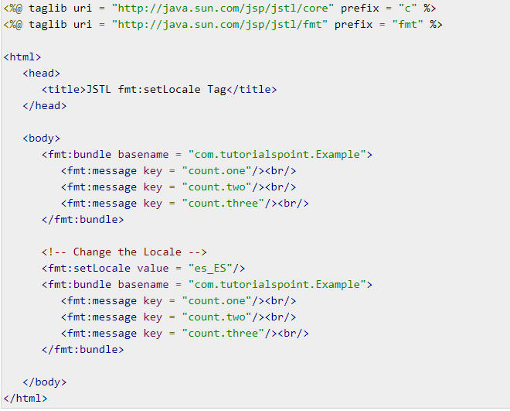
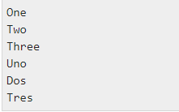
Internationalization(i18n) Actions
Example

Slide 25
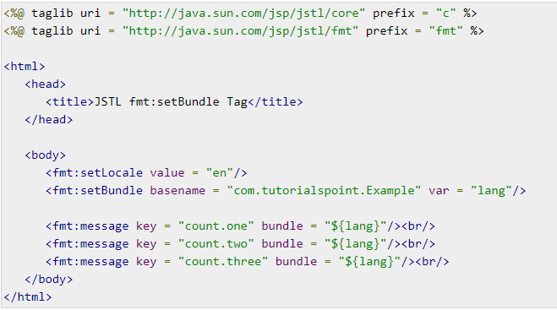

Internationalization(i18n) Actions
Example

Slide 26
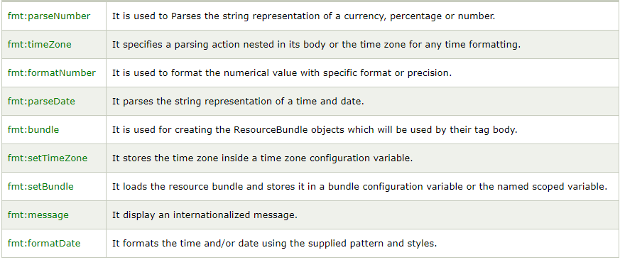
Formatting Actions
URI: http://java.sun.com/jsp/jstl/fmt ,prefix=“fmt”

Slide 27
SQL Actions
URI: http://java.sun.com/jsp/jstl/sql, prefix=“sql”
  <sql:query>
  <sql:update>
  <sql:transaction>
  <sql:setDataSource>
  <sql:param>
  <sql:dateParam>

Slide 28
XML Core Actions
URI: http://java.sun.com/jsp/jstl/xml, prefix=“x”
  <x:parse>
  <x:out>
  <x:set>

Slide 29
XML Flow Control Actions
URI: http://java.sun.com/jsp/jstl/xml, prefix=“x”
  <x:if>
  <x:choose>
  <x:when>
  <x:otherwise>
  <x:forEach>

Slide 30
XML Transform Actions
URI: http://java.sun.com/jsp/jstl/xml, prefix=“x”
  <x:transform>
  <x:param>

Slide 31
Functions Tag Library
URI: http://java.sun.com/jsp/jstl/functions, prefix=“x”
  <fn:contains>
  <fn:containsIgnoreCase>
  <fn:endsWith>
  <fn:escapeXml>
  <fn:indexOf>
  <fn:join>
  <fn:length>
  <fn:replace>

Slide 32
Functions Tag Library(2)
  <fn:split>
  <fn:startsWith>
  <fn:substring>
  <fn:substringAfter>
  <fn:substringBefore>
  <fn:toLoweCase>
  <fn:toUpperCase>
  <fn:trim>

Slide 33
How to use JSTL in a project
Download the lates version of jst from
http://www.apache.org/dist/jakarta/taglibs/standard/binaries/
Open the archive and, copy the jstl.jar and standart.jar files under the lib folder to the /WEB-INF/lib folder of your project
Define the taglib in jsp as:
<%@taglib prefix="c" uri="http://java.sun.com/jsp/jstl/core"%>
If the code above doesn’t works, use below
<%@taglib prefix="c" uri="http://java.sun.com/jsp/jstl/core_rt" %>

Slide 34
Summary
JSTL Introduction
  What is JSTL?
  What JSTL offer?
  JSTL Tag Libraries
Actions
  General purpose
  Conditional
  Iterator
  URL relate
  Internationalization (i18n)
  Formatting
  SQL
  XML core
  XML flow control
  XML transform
Function tag library
How to use JSTL in a project

